Slide 1
FUTURE OF AI TECHNOLOGY • MASTER TEMPLATE
AI Posture Rep Assistant
Real-time squat rep counting, posture-fault detection, and AI-generated
coaching — built as four cooperating edge + cloud agents.
Python
MediaPipe
OpenCV
OpenAI GPT-4o
Flask
pyttsx3

Slide 2
Product
What It dOES
AI Posture Rep Assistant is a Python application that watches a user perform squats through a webcam, counts repetitions, detects sustained posture faults (forward lean), and produces AI-generated coaching feedback — both during the workout (real-time voice coaching) and at the end of the session (a written summary report).
Local rep counting
Posture-fault detection
Tracks squat reps in real time with OpenCV + MediaPipe + NumPy — zero network latency.
Flags sustained forward-lean (spine angle) deviations from pose landmarks.
Real-time voice coaching
AI vision form audits
Offline TTS delivers milestones, alerts, and corrections mid-set.
Sends posture snapshots to GPT-4o when a fault persists >2s (max 2 calls/session).
Post-workout AI summary
Browser control panel
GPT-4o-mini synthesizes reps, calories, and faults into a coaching report.
Flask UI with Start/Pause/Stop/Quit, a live annotated video stream, and a report modal.

Slide 3
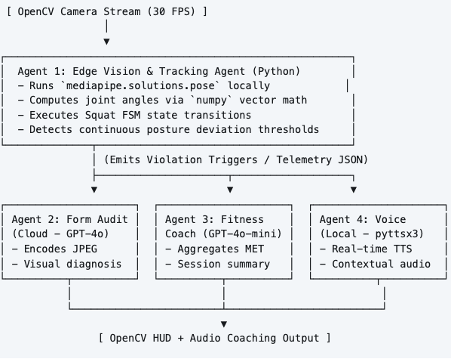
ARCHITECTURE
fOUR AGENTS, ONE PIPELINE
The system is built as a small multi-agent pipeline:
a local computer-vision agent does all real-time tracking,
a cloud LLM agents (OpenAI) are consulted only when needed (on sustained posture faults)
a cloud LLM agents (OpenAI) are consulted (at the end of the session) to keep cost and latency low.
A fourth agent provides offline text-to-speech coaching

Slide 4
PERFORMANCE SPOTLIGHT
AGENT DEEP DIVE
Agent | Runtime | Key Libraries | Trigger | Latency
1 · Vision & Tracking | Local CPU | mediapipe, numpy, opencv | Continuous (while cap.isOpened()) | <33ms / frame
2 · Form Audit | Cloud API | openai, base64, cv2 | Sustained fault >2.0s (max 2/session) | ~2-3s
3 · Fitness Coach | Cloud API | openai, json | End of session | ~1-2s
4 · Voice | Local thread | pyttsx3, queue, threading | Vision/session events | <50ms
Key Methods
› process_frame() — main pipeline: annotated frame, metrics, violation events
› _estimate_knee_angle() — visibility-gated dual-leg fusion
› _smooth_knee_angle() — EMA filter ahead of the rep FSM
› _update_rep_state() — FSM with a minimum inter-rep cooldown
› audit_posture() — fallback to deterministic feedback w/o an API key
› build_summary() — MET calorie math + templated fallback summary
› announce_*() — rep milestones, posture alerts, form notes, session end

Slide 5
OPERATIONS
CONFIGURATION & COST
Environment Variables
Per-Session Cost (OpenAI)
Variable | Default | Purpose
USER_WEIGHT_KG | 70 | Calorie calculation
FITNESS_GOAL | general fitness | Personalizes coaching copy
WORKOUT_MET | 5.0 | MET value for exercise intensity
CAMERA_INDEX | 0 | Webcam device index
OPENAI_API_KEY | (unset) | Enables audit/coach AI; else fallback
VOICE_ENABLED | true | Toggle voice feedback
VOICE_RATE / VOLUME | 150 / 1.0 | Speech WPM / volume
WEB_PORT | 5000 | Flask dev server port
Agent | Cost | Note
Vision Agent | $0.00 | runs locally
Voice Agent | $0.00 | runs locally
Audit Agent | ~$0.0025 | per snapshot (2 typical)
Coach Agent | ~$0.0001 | per session summary
~$0.0051 per 5-minute workout
≈ $0.10 / month at 20 sessions

Slide 6
stack
TECHNOLOGY STACK
Layer | Technology | Purpose
Language | Python 3.11+ | Unified runtime for CV, logic, and LLM orchestration
Video pipeline | opencv-python | Webcam input, canvas drawing, frame output
Pose detection | mediapipe 0.10.9 | 33 3D body keypoint tracking at 30+ FPS
Math / geometry | numpy | Vector operations for joint-angle calculation
AI coaching | openai SDK | Multimodal form auditing + session summaries
Voice feedback | pyttsx3 | Local offline text-to-speech coaching
Web frontend | Flask | Control panel, REST API, MJPEG video streaming
Testing | pytest, pytest-cov | Unit testing — 89 tests, 77% coverage

Slide 7
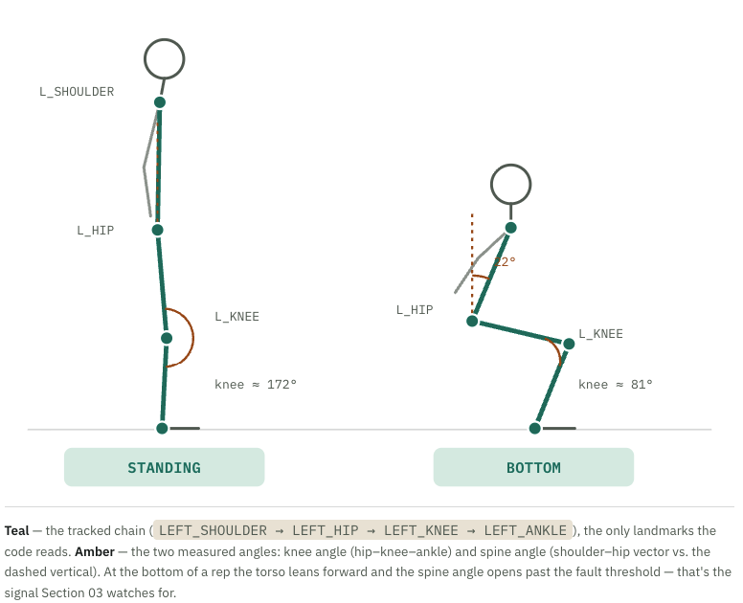
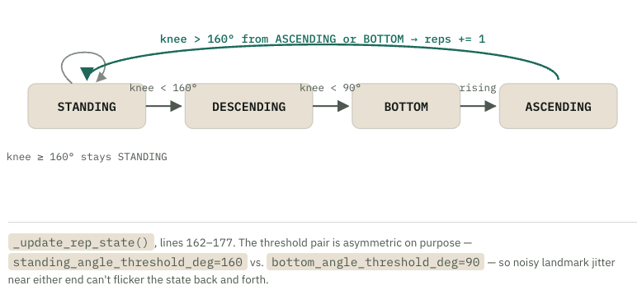
ALGORITHM DETECTION
ANATOMY OF A SQUAT REP
Four points, two angles
MediaPipe Pose returns 33 landmarks per frame. VisionAgent only reads four of them — all on the left side of the body — and reduces them to the two angles that everything downstream depends on.
Knee angle drives the rep counter
Every frame's knee angle is fed into a small state machine (SquatState). A rep is only counted on the way back up, so a partial dip that never breaks 90° never score

Slide 8
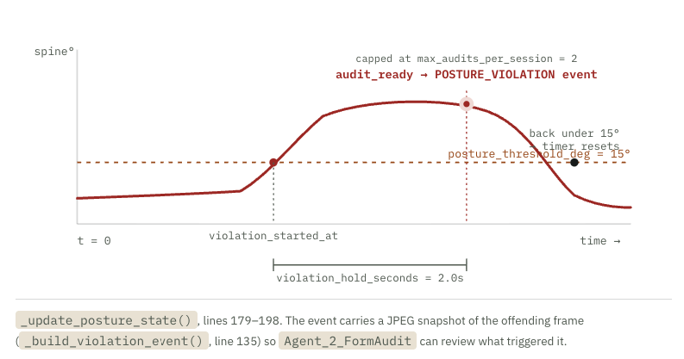
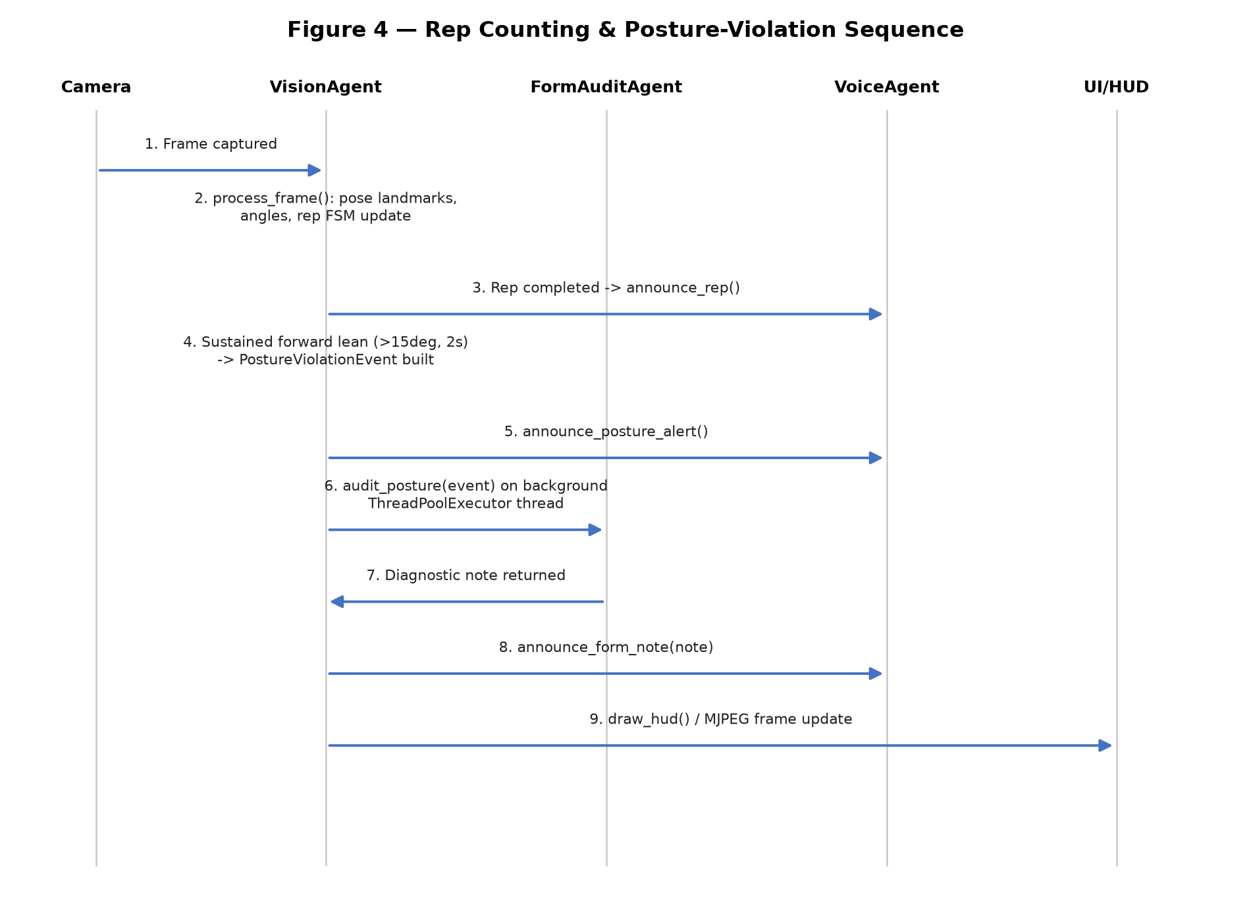
DETECTION ALGORITHM
POSTURE FAULT DETECTION
Spine angle drives the posture-fault timer
In parallel, the spine angle is checked against a much stricter limit. Crossing it doesn't fault immediately — it has to stay crossed for a sustained hold before an audit event fires, and each session only gets so many.

Slide 9
quality
Testing & coverage
89
77%
6
$0.10
passing tests
overall coverage
test files
est. / month, 20 workouts
Module | Coverage | Tests
server/agents/models.py | 100% | 6
server/agents/audit_agent.py | 100% | 9
server/agents/coach_agent.py | 100% | 12
server/agents/voice_agent.py | 79% | 23
server/agents/vision_agent.py | 87% | 28
main.py | 28%* | 5
webapp/session_manager.py | — (dedicated file) | 6
Notes
› *main.py needs live webcam access for full coverage
› webapp/ is covered by its own dedicated test file with a mocked camera
› Mocks: OpenAI API, MediaPipe, pyttsx3, webcam
› HTML coverage reports generated in htmlcov/

Slide 10
Dataset
Data contracts between agents
Agent 1 → Agent 2 (on posture fault)
Agents 1 & 2 → Agent 3 (session end)
PostureViolationEvent
sender: "Agent_1_Vision"
recipient: "Agent_2_FormAudit"
event_type: "POSTURE_VIOLATION"
metrics:
spine_angle_deg: 22.4
knee_angle_deg: 84.1
violation_duration_sec: 2.1
image_base64: "/9j/4AAQ..."
SessionSummaryPayload
user_profile:
weight_kg: 70, goal: "general fitness"
session_summary:
total_reps: 20, duration_seconds: 90
met_value: 5.0, calculated_calories: 8.75
total_posture_faults: 2
form_audit_diagnostics: [
"Torso folding forward, brace core..." ]
Agent 1 → Agent 4 (voice triggers, direct calls)
› announce_rep(rep_count) · announce_posture_alert(alert_count)
› announce_form_note(note, is_first) · announce_session_complete(rep_count, duration_seconds, fault_count)

Slide 11
Thank You
Questions? Explore the code, tests, and docs in the repository.
README.md — quick start & usage
agent.md — full agent specification
AI Posture Rep Assistant
14 / 14

